Slide 1
Utilisation de DevOps dans le contexte des SDO
Pierre Gauthier

Slide 2
Introduction
Comprendre comment les pratiques de DevOps peuvent etre appliqués dans les organismes de standardisations (SDO)
Ce travail examine la pratique courante de DevOps dans une SDO (TMF) pour la production de normes ou standards APIs
Elle examine le processus DevOps courant et etudie la migration vers un état idéal ou les concepts de First Way, Second et Third way sont appliques
Notes:
3 objectifs:
1-SDO Presenter cest quoi une SDO
2-Donner example d’un SDO TMF APIs
3-Utilsiant le project courant comment les concepts devops et amelioration des flux peut s’appliquer au TMF (exploratoire)
A la fin preiere de consuklter le rapport
25 mins

Slide 3
Objectifs
Presenter ce qu’est une SDO
Donner un example d’une SDO TMF APIs
Utiliser un projet courant et expliquer comment les concepts DevOps et amelioration des flux peuvent s’appliquer au TMF
C’est un travail exploratoire !
Priere de consulter le rapport pour plus de details

Slide 4
Agenda
Qu’est ce qu’une SDO
Example GSMA et TMF
Produits TMFs et Value Streams
Identification du Pipeline de Production d’API
Identification des Contraintes ou Goulots d’etranglements
Propositions pour une version future
Conclusions

Slide 5
Qu’est qu’un SDO ?
Standard Development Organization
Un organisme de normalisation ou de standardisation
Une organisation qui élabore, publie et maintient des normes techniques.
L'objectif d'un SDO est d'établir un ensemble de lignes directrices ou de protocoles qui favorisent l'uniformité, l'interopérabilité et la qualité dans un secteur industriel ou un domaine particulier.
Les SDO peuvent avoir une portée nationale, régionale ou internationale.

Slide 6


Examples
Global System for Mobile Communications Association
connue pour son rôle dans le développement de la norme de téléphonie mobile GSM (Global System for Mobile Communications), qui est devenue la norme de facto pour la communication mobile à travers le monde
https://www.gsma.com/
un forum de collaboration pour les fournisseurs de services CSP (Bell, Rogers etc..) , les fournisseurs de technologies (Oracle, Google etc..)et les organisations connexes, qui travaillent ensemble pour développer des normes, des meilleures pratiques et des outils pour aider les entreprises à gérer leur transformation numérique.
fournit des outils, des normes et des pratiques exemplaires pour aider les entreprises à simplifier leurs processus, à améliorer leur efficacité opérationnelle et à offrir de meilleurs services à leurs clients
https://www.tmforum.org

Slide 7

Production de Normes APIs
Les Produits les plus importants des SDO sont les normes utilisees par leurs clients les operateurs Telco (Bell, BT, Orange ..) , les vendeurs (Ericsson, Amdocs, Oracle …) et les entreprises d’integration (Deloitte, CGI etc..)
Le TMF produit des normes APIs (standards) mais aussi des Produits de validation de conformite des APIs CTK

Slide 8






What are the TM Forum Open APIs ?
A suite of APIs making it easier to
create
build
and operate
complex, innovative services
REST based
IoT
Next Gen OSS/BSS
Artificial Intelligence
TM Forum Open APIs
Data Governance
Edge Computing
5G
Notes:
SCRIPT:
TM Forum Open APIs are a set of standardized RESTful APIs that are designed to help service providers and software developers build digital services and applications more quickly and efficiently.
TMF Forum Open APIs is a suite of APIs making it easier to create, build and operate complex innovative services. The APIs are REST-based. It is important to consider that the APIs are not only meant to build OSS/BSS but also can be used in the context of management solutions for IoT, Smart City, Big Data, and NFV (Zoom Open APIs)

Slide 9
Examples of Open APIs Currently Available
TM Forum Open APIs for Enabling Ecosystems
Product Ordering
API
Product Catalog
API
Product Inventory API
Billing
API
Customer
API
Performance
API
SLA Management
API
Trouble Ticket
API
Onboarding
API
Privacy
API
Service Activation
& Provisioning
API
From IoT device management to complex B2B value fabrics
Managing partner arrangements across any business boundary
Onboarding, SLA management, policy management and revenue sharing & settlement
Notes:
SCRIPT
Open APIs are part of an API Ecosystem. Focus on the fact that there are of inter-operable APIs covering many aspects from IoT Management up to Complex B2B Fabrics.
https://projects.tmforum.org/wiki/display/API/Open+API+Table
TM Forum provides a set of Open APIs for the telecommunications industry. Here are some examples of TM Forum Open APIs :
Customer Management: The Customer Management API provides a standard way to create, read, update, and delete customer records, as well as retrieve customer account and contact information.
Product Catalog: The Product Catalog API provides a standard way to manage products and services that are offered to customers, including the ability to create, read, update, and delete product and pricing information.
Order Management: The Order Management API provides a standard way to manage the entire order lifecycle, including the ability to create, read, update, and delete orders, as well as track order status and manage order changes.
Billing Management: The Billing Management API provides a standard way to manage customer billing, including the ability to generate invoices, process payments, and manage customer balances.
Trouble Ticketing: The Trouble Ticketing API provides a standard way to manage customer service requests and trouble tickets, including the ability to create, read, update, and delete tickets, as well as track ticket status and manage ticket routing and escalation.
Overall, TM Forum's Open APIs can help telecommunications companies to streamline their operations, reduce costs, and improve customer satisfaction. By adopting these APIs, companies can accelerate the development and deployment of customer-facing services, and ensure that these services meet the needs and expectations of their customers.

Slide 10

Produits TMFs
Produit API Swagger: Logiciel. Contrats normalises utilise dans different contextes d’integration Core Commerce, IoT et Reseaux
API User Guide: Guide d’utilisation des APIs avec Uses Cases et Examples
Produit RI: Logiciel d’implementationde Reference en Node.js , Docker
API Profile: Specification de la fonctionalite de l’API User Guide
Produit CTK: Suites de conformite CTK (Conformance Test Kits)
Produit Postman: Code de suites de Tests
Notes:
Il existe plusieurs Value streams au niveau de la production des APIs

Slide 11
Open APIs Table
Produits + Value Chains
http://www.tmforum.org/open-apis/
http://projects.tmforum.org/wiki/display/API/Open+API+Table
Notes:
Here the focus is on showing and walkthrough the APIs from the Open API Table.
The instructor should be looking at the Ecosystem Portal Web Page
http://projects.tmforum.org/wiki/display/API/Open+API+Table
http://www.tmforum.org/open-apis/

Slide 12

Value Chains
Development des contrats Swaggers API (Machine Readable)
Development des manuel d’utilisations, meilleurs pratiques API User Guide( Human Readbale)
Development du sample API Implementation Code
Development du code test API (Postman)
Development des suites de conformite CTK (Conformance Test Kits)

Slide 13
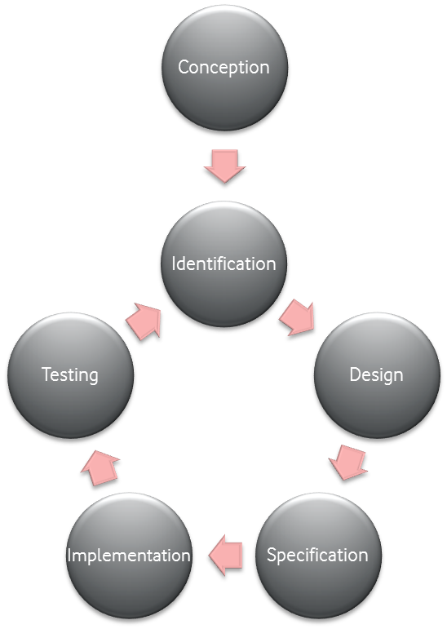
Cycle de development des APIs dans le TMF
API Proposal
Membership Input
Fully compliant API implementation Sandbox
CTK script
Updated deployment guide
Updated API Specification
document
High-level API
requirement document
Identified use-cases
Requirements
Crowdsourcing Template
API Profile
API Implementation Code
POSTMAN testing suite
Deployment guide
Updated API specification
Updated Swagger
API Specification Document User Guide
Swagger
Conformance Profile
Notes:
Script:
The API Development Lifecycle typically includes the following stages:
Conception, Identification and Design: This is the initial stage of API Development Lifecycle, where the objectives of the API are defined, and the API design is planned. The API requirements are captured in the API Profile document.
Specification: In this stage, the API's design is created, which includes creating a detailed specification of the API, defining the data models, and creating the API documentation. We also define the Conformance Profile at this stage.
Implementation: This stage involves the actual coding of the API. This includes creating the API logic, database schema, and error-handling logic. The code is typically tested during development to ensure it meets the requirements and is free of bugs.
Testing and Deployment: The API is tested to ensure that it meets the requirements and functions as intended. This includes testing the API endpoints, verifying the data exchange format, and checking the apis concerning the conformance profile. The API is deployed in the TMF Forum production environment, and it is made available for use. This stage involves configuring the API servers, setting up monitoring and alerting, and ensuring that the API is secure.
Each stage in the API Development Lifecycle is critical to ensuring the API's success. By following a structured process, businesses can create reliable and efficient APIs that meet the needs of their users.

Slide 14
Roles
SME
SDO Team
Employe du SDO (Architecte, Developeur)
SDO Members (Amdocs, Oracle, Bell etc..)
Subject Matter Expert

Slide 15
Pipeline de Production API Contract Swagger
API
Inception
SDO Team
Review
API
Profile
SME
Review
Tooling Environment
Configuration
JSON Schema Data Model
SDO Team
Review
Tooling
API Config
Automated
Generation of Swagger
Swagger SME
Review
API Deployment

Slide 16
Pipeline de Production API Contraintes
Dev
Dev
Ops
API
Inception
SDO Team
Review
API
Profile
SME
Review
Tooling Environment
Configuration
1
2
Lead Time Medium
%C/A Low
Process Time Low
Lead Time Low
%C/A Low
Process Time Low
Lead Time High
%C/A Medium
Process Time High
Lead Time Low
%C/A Medium
Process Time Low
Lead Time High
%C/A Medium
Process Time Medium
3
Ops
Ops
JSON Schema Data Model
SDO Team
Review
Tooling Dev
API Config
(Automated)
Swagger
Swagger SME
Review
API Deployment
4
5
6
Lead Time High
%C/A Medium
Process Time High
Lead Time Low
%C/A Low
Process Time Low
Lead Time High
%C/A Low
Process Time Low
Lead Time Low
%C/A High
Process Time Low
Lead Time Low
%C/A Low
Process Time Low
Lead Time High
%C/A High
Process Time Low
Notes:
Kanban lead time is the time between a request being made and a task being released. It's the total time the client is waiting for a task to be delivered.
It’s the total time the client is waiting for a task to be delivered. Lead time is frequently used by Kanban teams to evaluate customer satisfaction.
Kanban cycle time is calculating the actual work-in-progress time. It tracks how long a task stays in the different process stages.
The higher the % C/A, the higher the flow rate in the value stream.
The lower the % C/A, the lower the flow rate, because a lot of time will be consumed by rework that has to be done
% Change approval: This could refer to the percentage of changes that are approved in a software development pipeline. DevOps teams often use automated testing and continuous integration/continuous delivery (CI/CD) pipelines to streamline the process of building and releasing software, and change approval is an important step in that process.

Slide 17
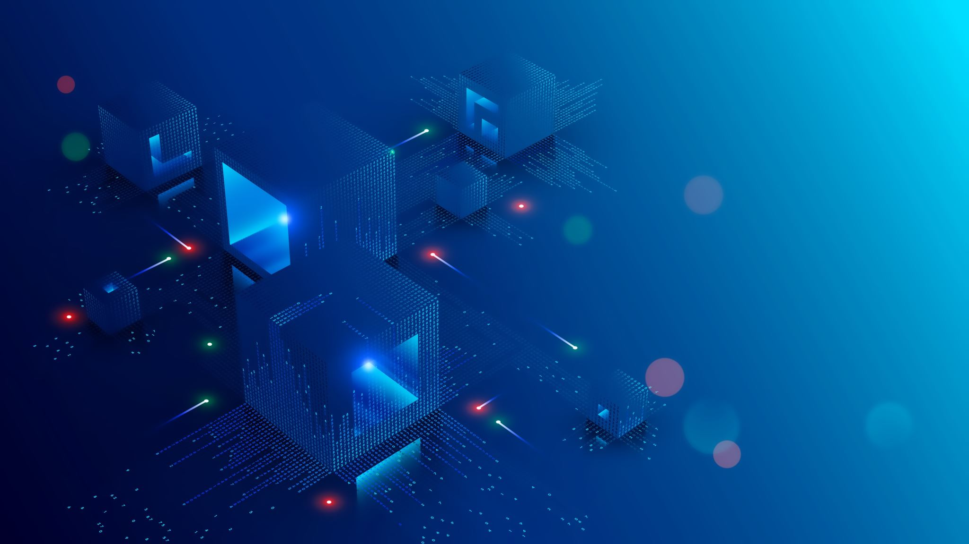
6 Contraintes
API Profile –Organizationel
Environnement de Production
JSON Data Model
Configuration API Tooling
Fabrication Swagger
Deploiement de l’API

Slide 18

Etat Futur

Slide 19

What we need ?
Increase Dev Team autonomy
Increase Automation
Create on Demand Dev Environment
Increase Peer Reviews
Add Automated tests and verification
Increase Feedback
Increase autonomy of dev team to deploy solutions
Add telemetry and metrics
Integrate with other value chains CTK, API Documentation, Reference Implementations

Slide 20
5-Contrainte Fabrication Swagger
Add Automated Tests Syntax and Patterns
Check Examples can be compiled and executed via Spring payload test tool
Idea is to remove all defects syntactical, pattern problems and examples before swagger is reviewed by peers and final by sme
Reducing the number of defects before reviewing and deploying to production
Ops
Tooling
API Config
(Automated)
Swagger
Swagger SME
Review
5
Lead Time Low
%C/A Low
Process Time Low
Lead Time Low
%C/A Low
Process Time Low
Lead Time Low
%C/A High
Process Time Low
Dev
Tooling
API Config
(Automated)
Swagger
Swagger
Automated
Code Inspection
Swagger Examples
Spring Test
Swagger Peer
Review
Swagger SME
Review
Lead Time Low
%C/A Low
Process Time Low
Lead Time Low
%C/A Low
Process Time Low
Lead Time Low
%C/A Low
Process Time Low
Lead Time Low
%C/A Low
Process Time Low
Lead Time Low
%C/A High
Process Time Low
Lead Time Low
%C/A Low
Process Time Low

Slide 21

Conclusions
L’application systematique des concepts de DevOps nous a permis d’identifier les limites mais aussi d’identifier des voies d’evolution des pipelines de production des APIs du Forum
Certaines de ces conclusions sont deja mise en oeuvre dans la version 5 des APIs

Slide 22

Q&A

